Slide 1
Finding Access Violation in Smart Contracts with Analysing Transaction
Pritom Rajkhowa

Slide 2
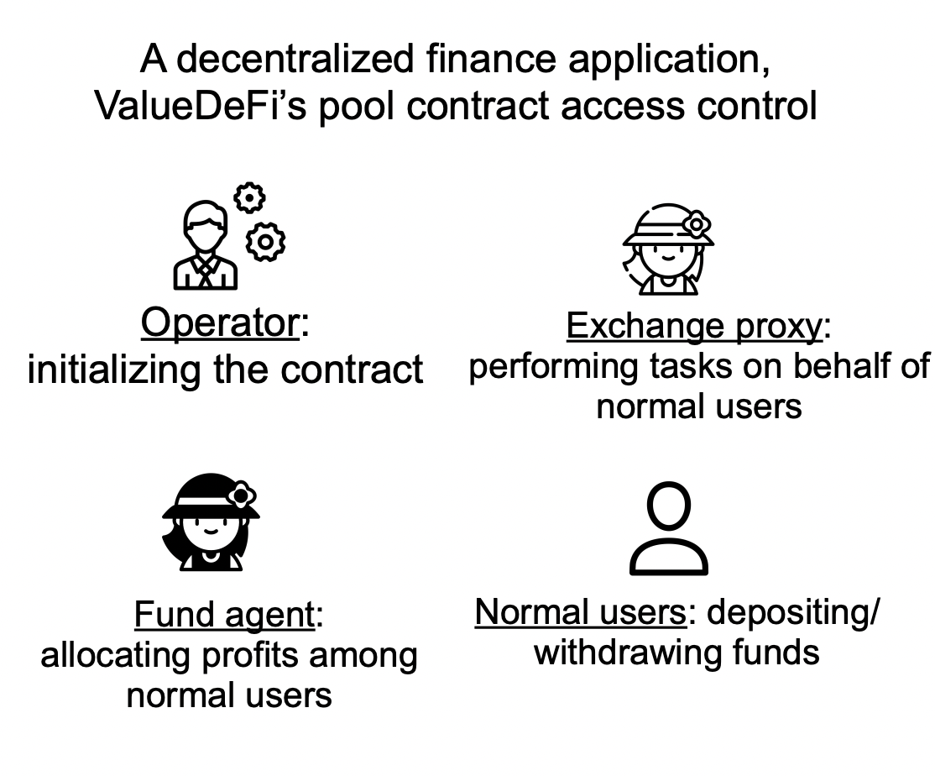
Smart Contract
• Manage valuable assets
• Involve multiple types of users with different capabilities
• Self-governed and once deployed, contract code cannot be changed
Enforcing access control correctly is crucial for smart contract implementations

Slide 3
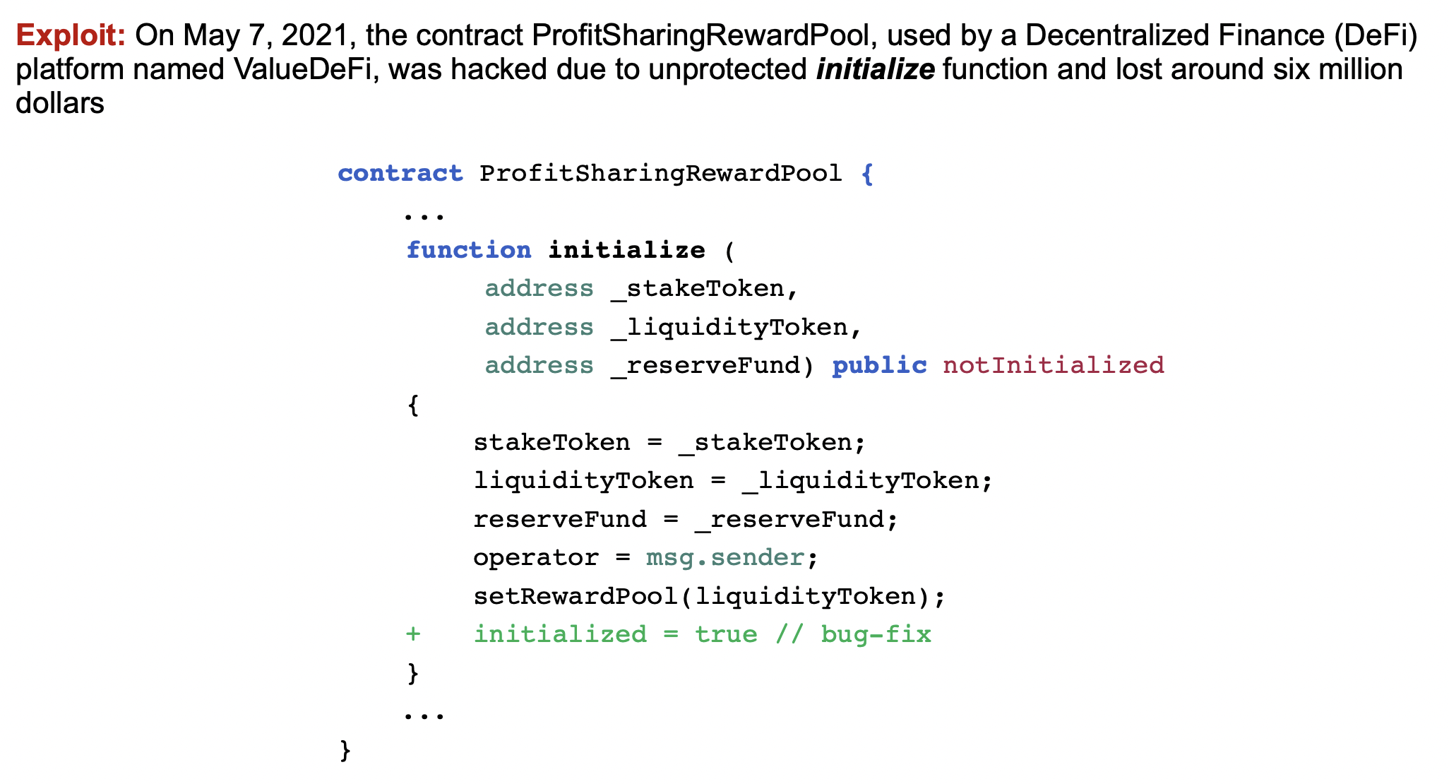
A permission bug in ValueDeFi

Slide 4
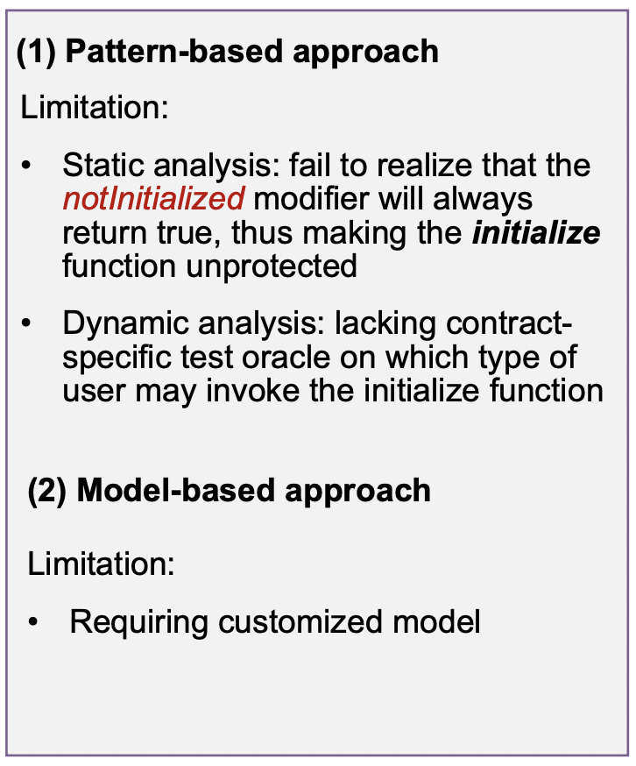
A permission bug in ValueDeFi

Slide 5
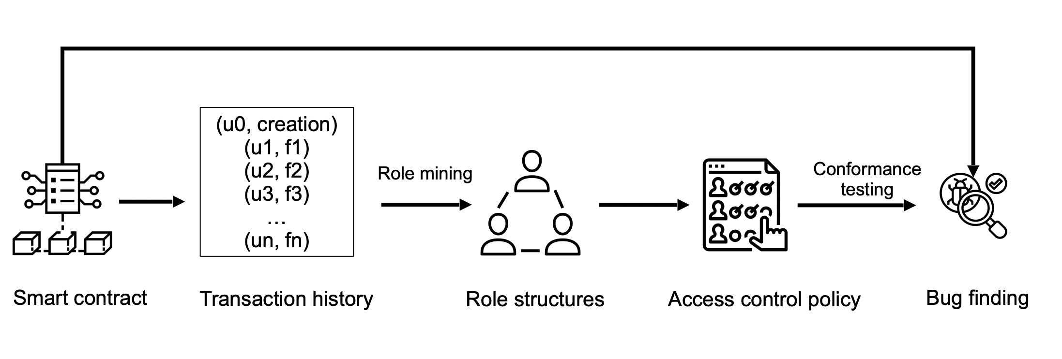
Smart contract permission bug finding

Slide 6
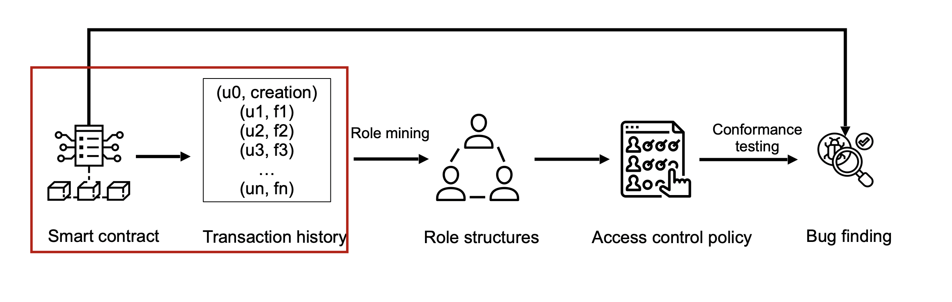
Smart contract permission bug finding
▪ Extract user function access log from transaction history

Slide 7
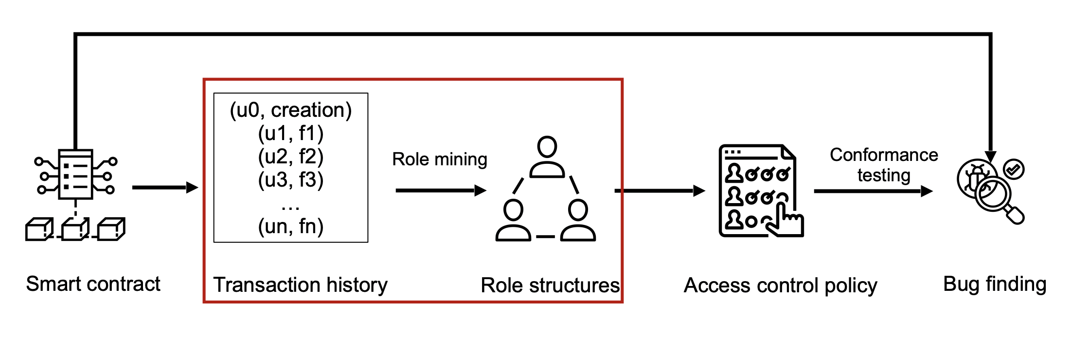
Smart contract permission bug finding
▪Role mining ---> infer user roles from existing user function access log.

Slide 8
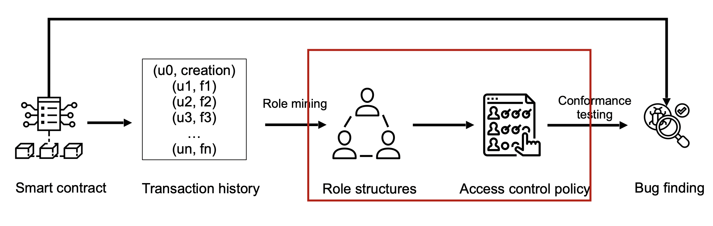
Smart contract permission bug finding
▪Recover information-integrity access control policy from mined role structures.

Slide 9
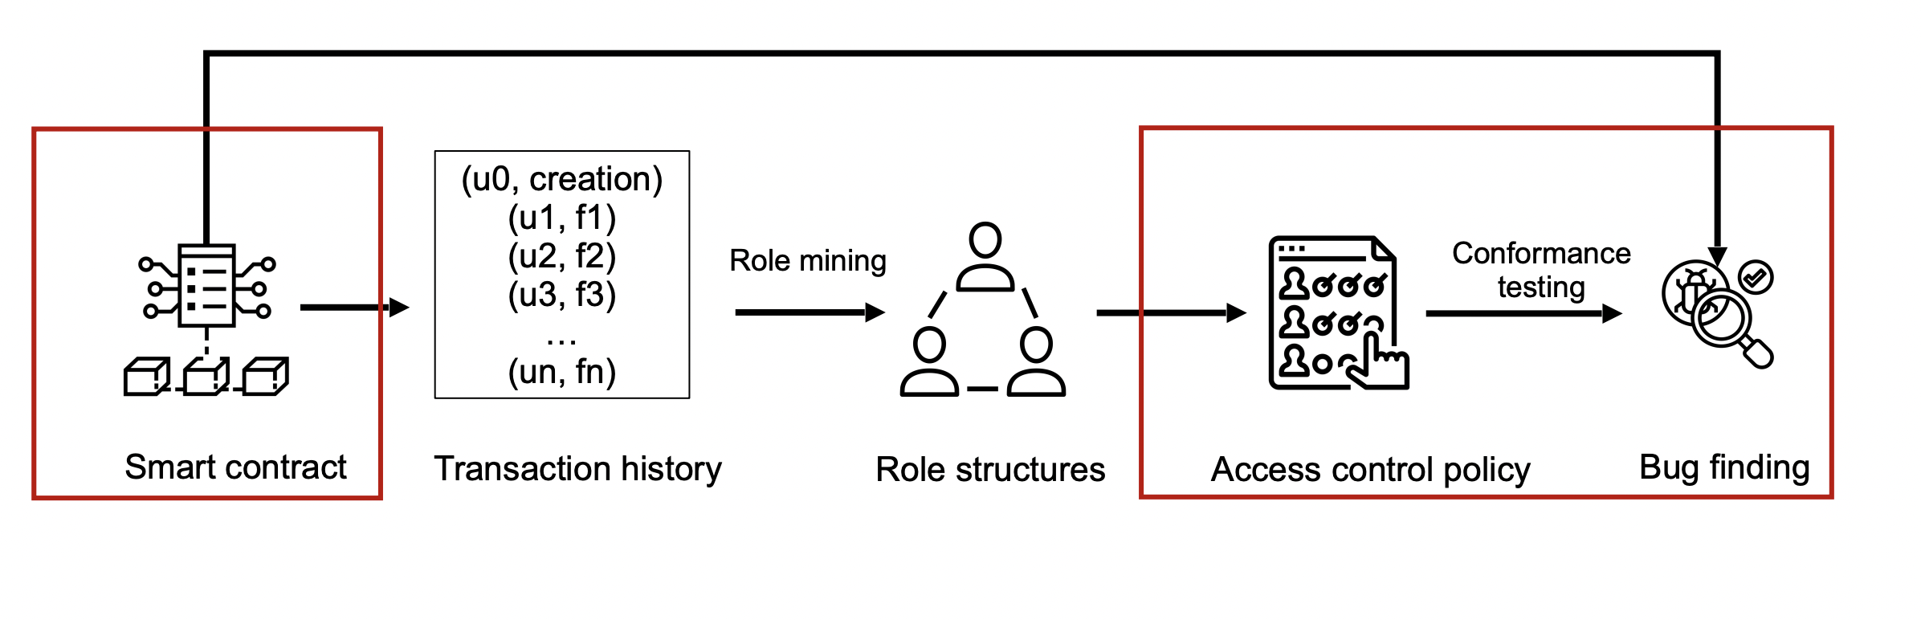
Smart contract permission bug finding
▪Conformance testing --> Check the conformance between contract implementation and its access control policy

Slide 10
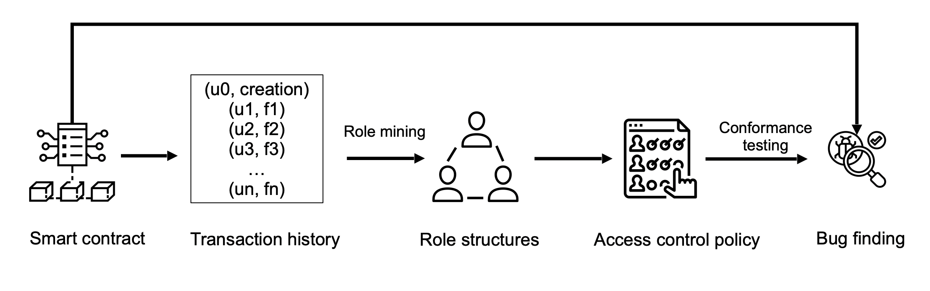
Conclusion
(1) Learn permission model from transaction history.
(2) Generate executable exploits.

Slide 11
Thanks

